Slide 1
The beginning of the maturity process
Lessons from the Songs of Solomon
09/03/19

Slide 2
Songs of Solomon (intro)
SOS 1:1 - The song of songs, which is Solomon’s
Theme:
The revelation of God’s emotion (love, delight, desire) for His people
The greatest (first) commandment
Characters | Spiritual interpretation
King Solomon (the beloved) | Christ the Bridegroom King
The Shulamite women | The bride of Christ (The Church)
Daughters of Jerusalem | Sincere but spiritually immature believers
The watchmen | Spiritual leadership

Slide 3
Songs of Solomon (recap)
Jesus’ great love for His church:
i. Loved the Church and gave Himself (Rom 5:8)
ii. Sanctifying (cleanse) the Church (John 17:17)
iii. Preparing His prefect Church (Eph 4:11-12)
The revelation of His love (heart/emotion)
i. Develop love obedience
ii. Progressive maturity
- challenging the comfort zone
- discipline to set us free
iii. Serving others with and unto the Lord

Slide 4
Luke 1:13-17, Mal 4:5-6
¹⁷He will also go before Him in the spirit and power of Elijah, ‘to turn the hearts of the fathers to the children,’ and the disobedient to the wisdom of the just, to make ready a people prepared for the Lord.
Respond to the love of the Father
Respond to your spiritual parents
Respond to your parents
- Jesus is coming back for a Perfect and Pure Bride for Himself (His Church)

Slide 5

The greatest commandment
Matt 22:37-39 - Jesus said to him, “‘You shall love the Lord your God with all your heart, with all your soul, and with all your mind.’ This is the first and great commandment. And the second is like it: ‘You shall love
your neighbour as yourself.’
John 15:9-10 - “As the Father loved Me, I also have loved you; abide in My love. If you keep My commandments, you will abide in My love, just as I have kept My Father’s commandments and abide in His love.

Slide 6
1) Begins with a declaration of love
SOS 1:2 - Let him kiss me with the kisses of his mouth – For your love is better than wine
A decision to encounter Jesus in intimacy
- Dan 1:8 - But Daniel purposed in his heart that he would not defile himself with the portion of the king’s delicacies, nor with the wine which he drank; therefore he requested of the chief of the eunuchs that he might not defile himself.
- Phil 3:10 - that I may know Him and the power of His resurrection, and the fellowship of His sufferings, being conformed to His death
A prayer for grace to love Jesus with all our heart
Father, let Him kiss me with the kisses of His Word.”

Slide 7
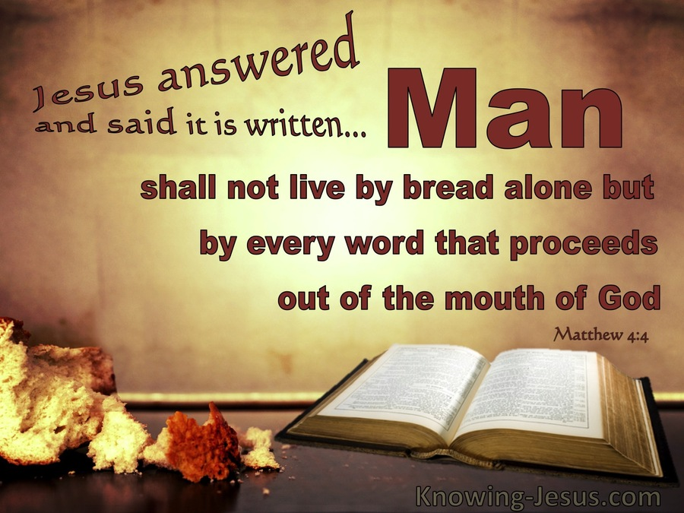
2) Begins with receiving His Word
SOS 1:2 - Let him kiss me with the kisses of his mouth – For your love is better than wine
Spiritual intimacy = Encountering the Word of God by the Holy Spirit touching our heart.
(Matt 4:4)
Expands our capacity
to receive His Love and
response in His love.

Slide 8

3) Begins by setting our priorities
SOS 1:2 - Let him kiss me with the kisses of his mouth – For your love is better than wine
Wine = good wine of God’s blessing
= bad wine of sins pleasure
What are we pursuing and for what purpose? Matt 6:33, Col 3:2 (The 8 Ps)
His love is better than anything
the world can offer
(The pleasure of His Word can
frees us from sin’s bondage)

Slide 9
4) Begins with the paradox of Grace
SoS 1:5,8,15 - Dark vs lovely, fair/fairest
⁵I am dark (in heart), but lovely (to God)…
⁶…my own vineyard (heart) I have not kept
Dark = fallenness, sinfulness, weakness
We are lovely to God because of His grace.
Run to Him, not from Him when we fall.
The enemy wants to accuse us, put us to shame and paralyse us.
“My own heart” = Sincere believers (2 Cr 13:14)

